Slide 1
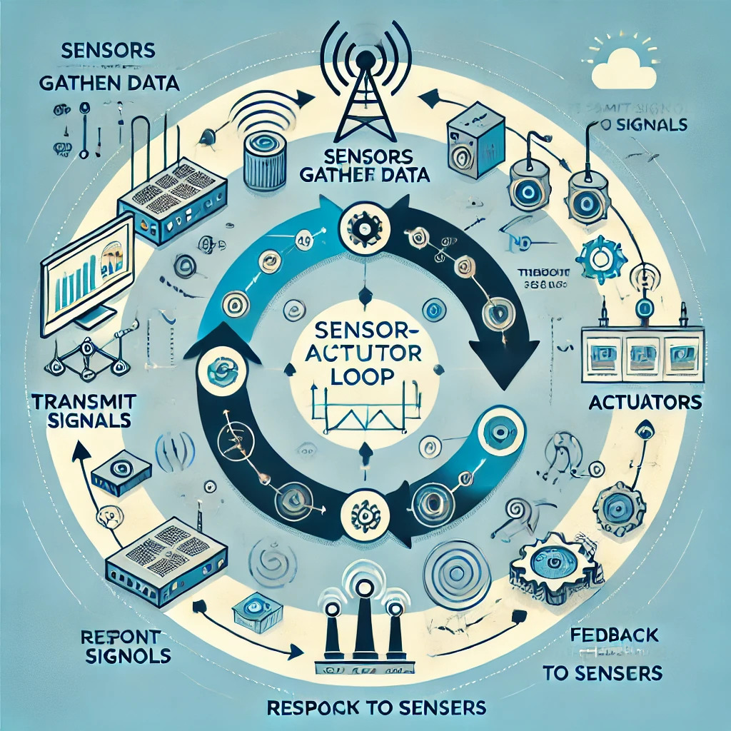
Innovative Use of Sensors and Actuators
Introduction to Sensors and Actuators
.
Sensors: Devices that detect physical changes in the environment (temperature, light, pressure, etc.) and convert them into signals that can be read by humans or machines. For instance, a temperature sensor measures thermal energy and outputs an electrical signal that can be monitored or recorded.
Actuators: Devices that take signals and convert them into physical actions. They may use electrical, hydraulic, or pneumatic energy to perform tasks, such as moving a robotic arm or opening a valve.

Slide 2
Types of Sensors and Actuators
Types of Sensors:
Analog Sensors: Produce continuous electrical signals proportional to the measured quantity (e.g., thermocouples for temperature).
Digital Sensors: Output discrete signals for easier interpretation, often using binary systems (e.g., proximity sensors).
Active Sensors: Generate their own signal for measurement, often using a power source (e.g., radar sensors).
Passive Sensors: Require an external power source to produce a signal, responding to external stimuli (e.g., photodiodes).
Types of Actuators:
Electric Actuators: Convert electrical energy into mechanical energy (e.g., stepper motors used in 3D printers).
Hydraulic Actuators: Utilize pressurized fluid to create motion, ideal for heavy lifting (e.g., cranes).
Pneumatic Actuators: Use compressed air for motion, commonly found in industrial applications (e.g., air cylinders in manufacturing).

Slide 3
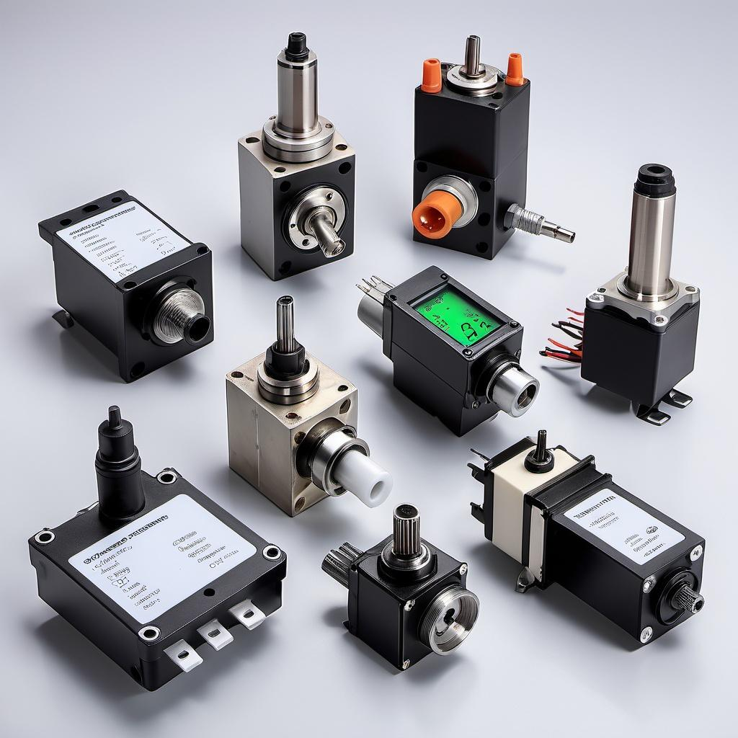
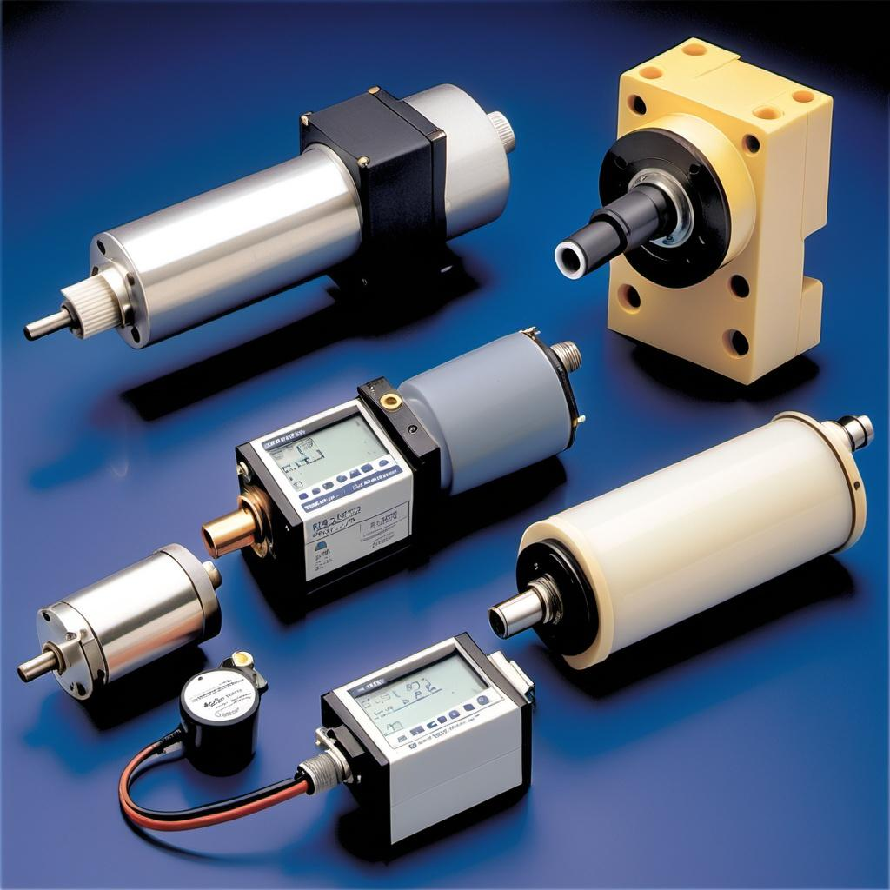
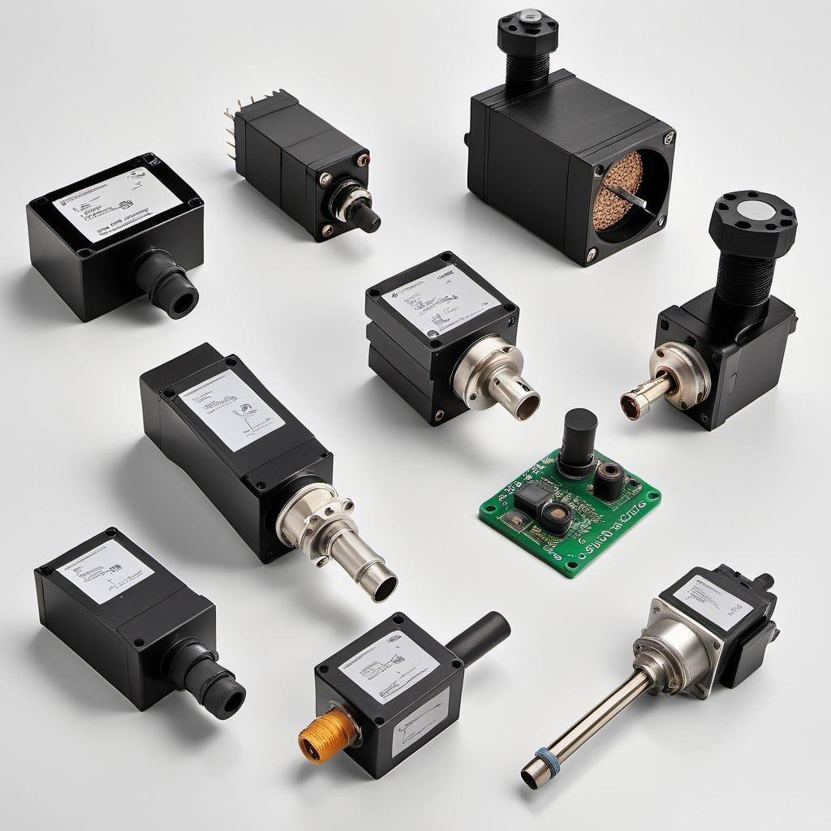

Slide 4
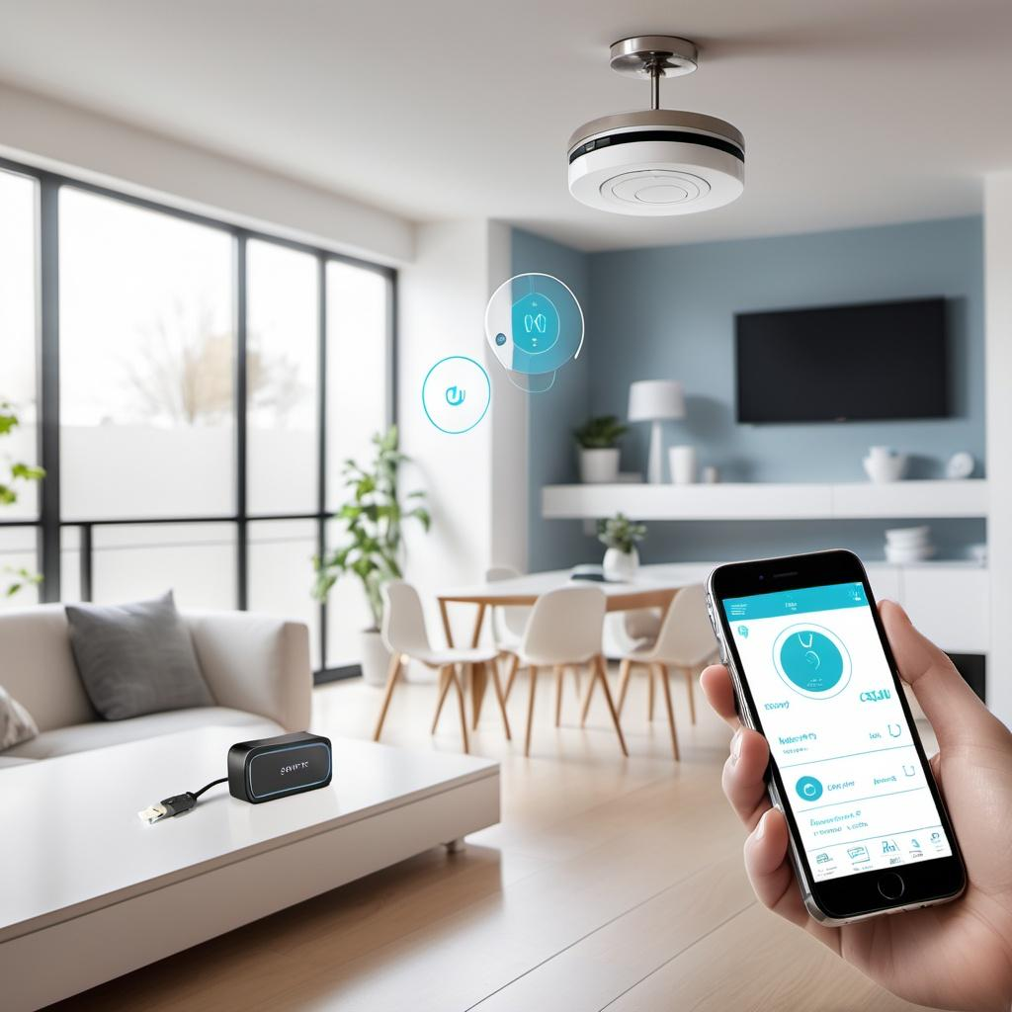
Applications in Various Fields
Sensors and actuators are integral in multiple industries:
Automotive: Used in engine management systems, anti-lock braking systems (ABS), and safety features like airbags.
Healthcare: Found in medical devices like heart rate monitors, insulin pumps, and imaging systems.
Robotics: Essential for movement control, environmental sensing, and automation.
Agriculture: Applied in smart irrigation systems and soil moisture monitoring to enhance efficiency and crop yield.

Slide 5
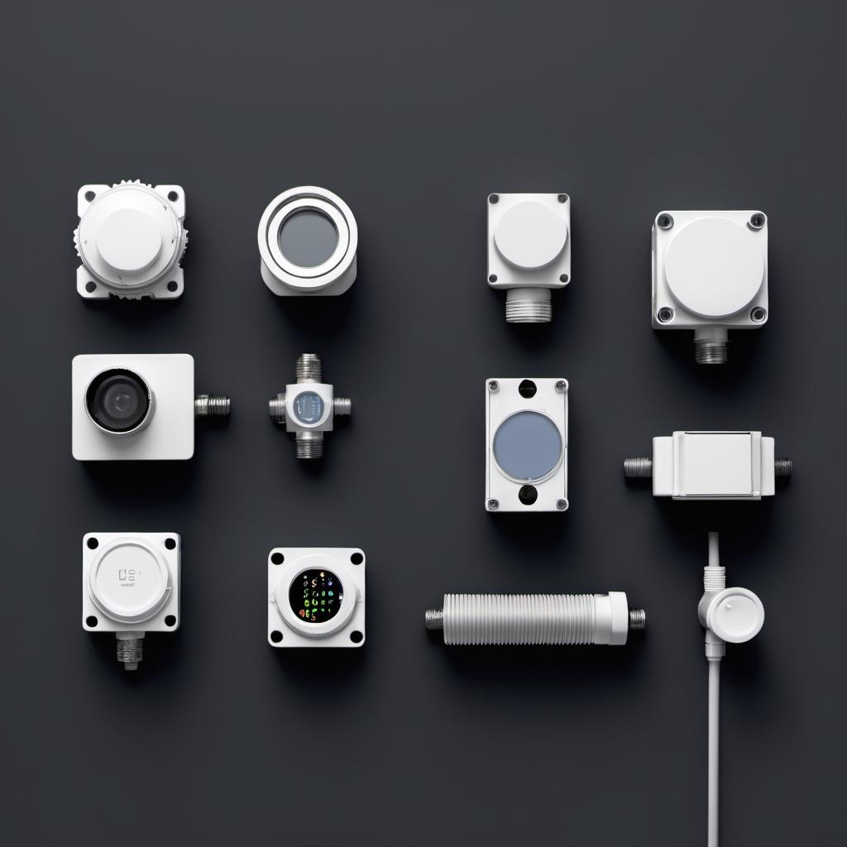
Sensor Technology
Sensor Classification:
Sensors can be classified based on various criteria:
By Operating Principle:
Resistive Sensors: Measure changes in resistance (e.g., thermistors for temperature).
Capacitive Sensors: Detect changes in capacitance (e.g., touch screens).
Inductive Sensors: Operate on electromagnetic induction (e.g., metal detection).
By Output Type:
Analog Output Sensors: Produce continuous signals (e.g., thermocouples).
Digital Output Sensors: Provide discrete binary signals (e.g., digital temperature sensors).
By Functionality:
Temperature Sensors: Measure thermal energy (e.g., thermistors, infrared sensors).
Motion Detectors: Detect movement (e.g., PIR sensors).
Pressure Sensors: Measure force exerted by fluids (e.g., tire pressure sensors).
By Application Domain:
Industrial Sensors: Used in manufacturing (e.g., flow and level sensors).
Environmental Sensors: Monitor air quality and climate (e.g., humidity sensors).
Medical Sensors: Used for patient monitoring (e.g., pulse oximeters).

Slide 6
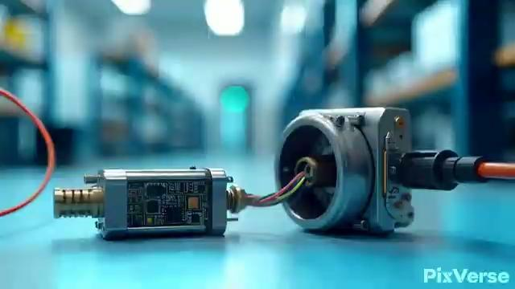

Slide 7
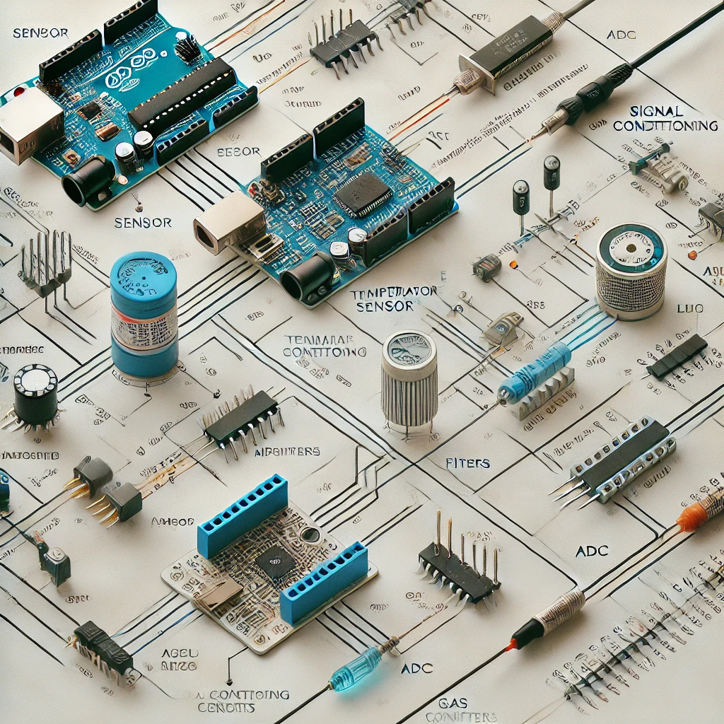
Sensor Interfacing and Signal Conditioning
Sensor Interfacing: The process of connecting sensors to microcontrollers involves ensuring compatibility regarding voltage levels and data formats. It's crucial for accurate data collection and processing.
Signal Conditioning: Involves refining raw sensor output to improve data quality. This includes:
Amplification: Increasing signal strength for better readability.
Filtering: Removing noise from the signal for clear interpretation.
Analog-to-Digital Conversion: Transforming analog signals into digital form for processing.

Slide 8
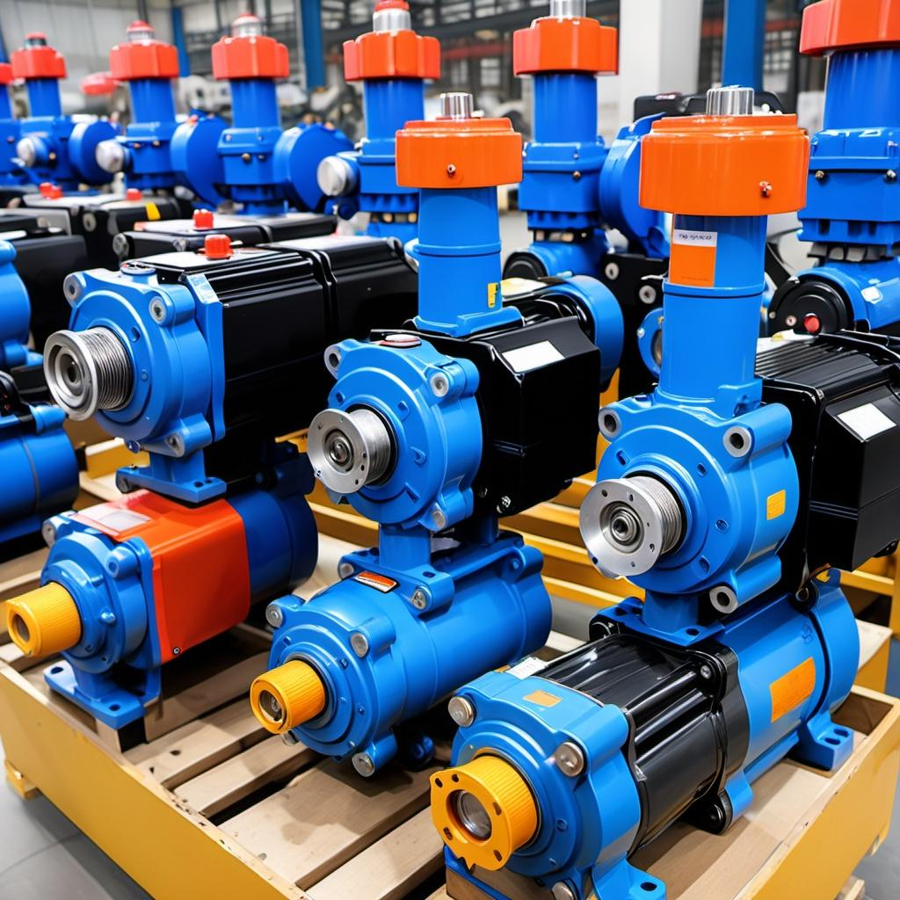
Actuator Technology
Types of Actuators:
Electric Actuators: Commonly used in robotics and automation, converting electrical signals into precise movements (e.g., servos in drones).
Hydraulic Actuators: Ideal for heavy machinery, they use liquid pressure to create motion and are often found in construction equipment (e.g., excavators).
Pneumatic Actuators: Utilize compressed air for operation, suitable for tasks requiring rapid action, often found in packaging machines.

Slide 9
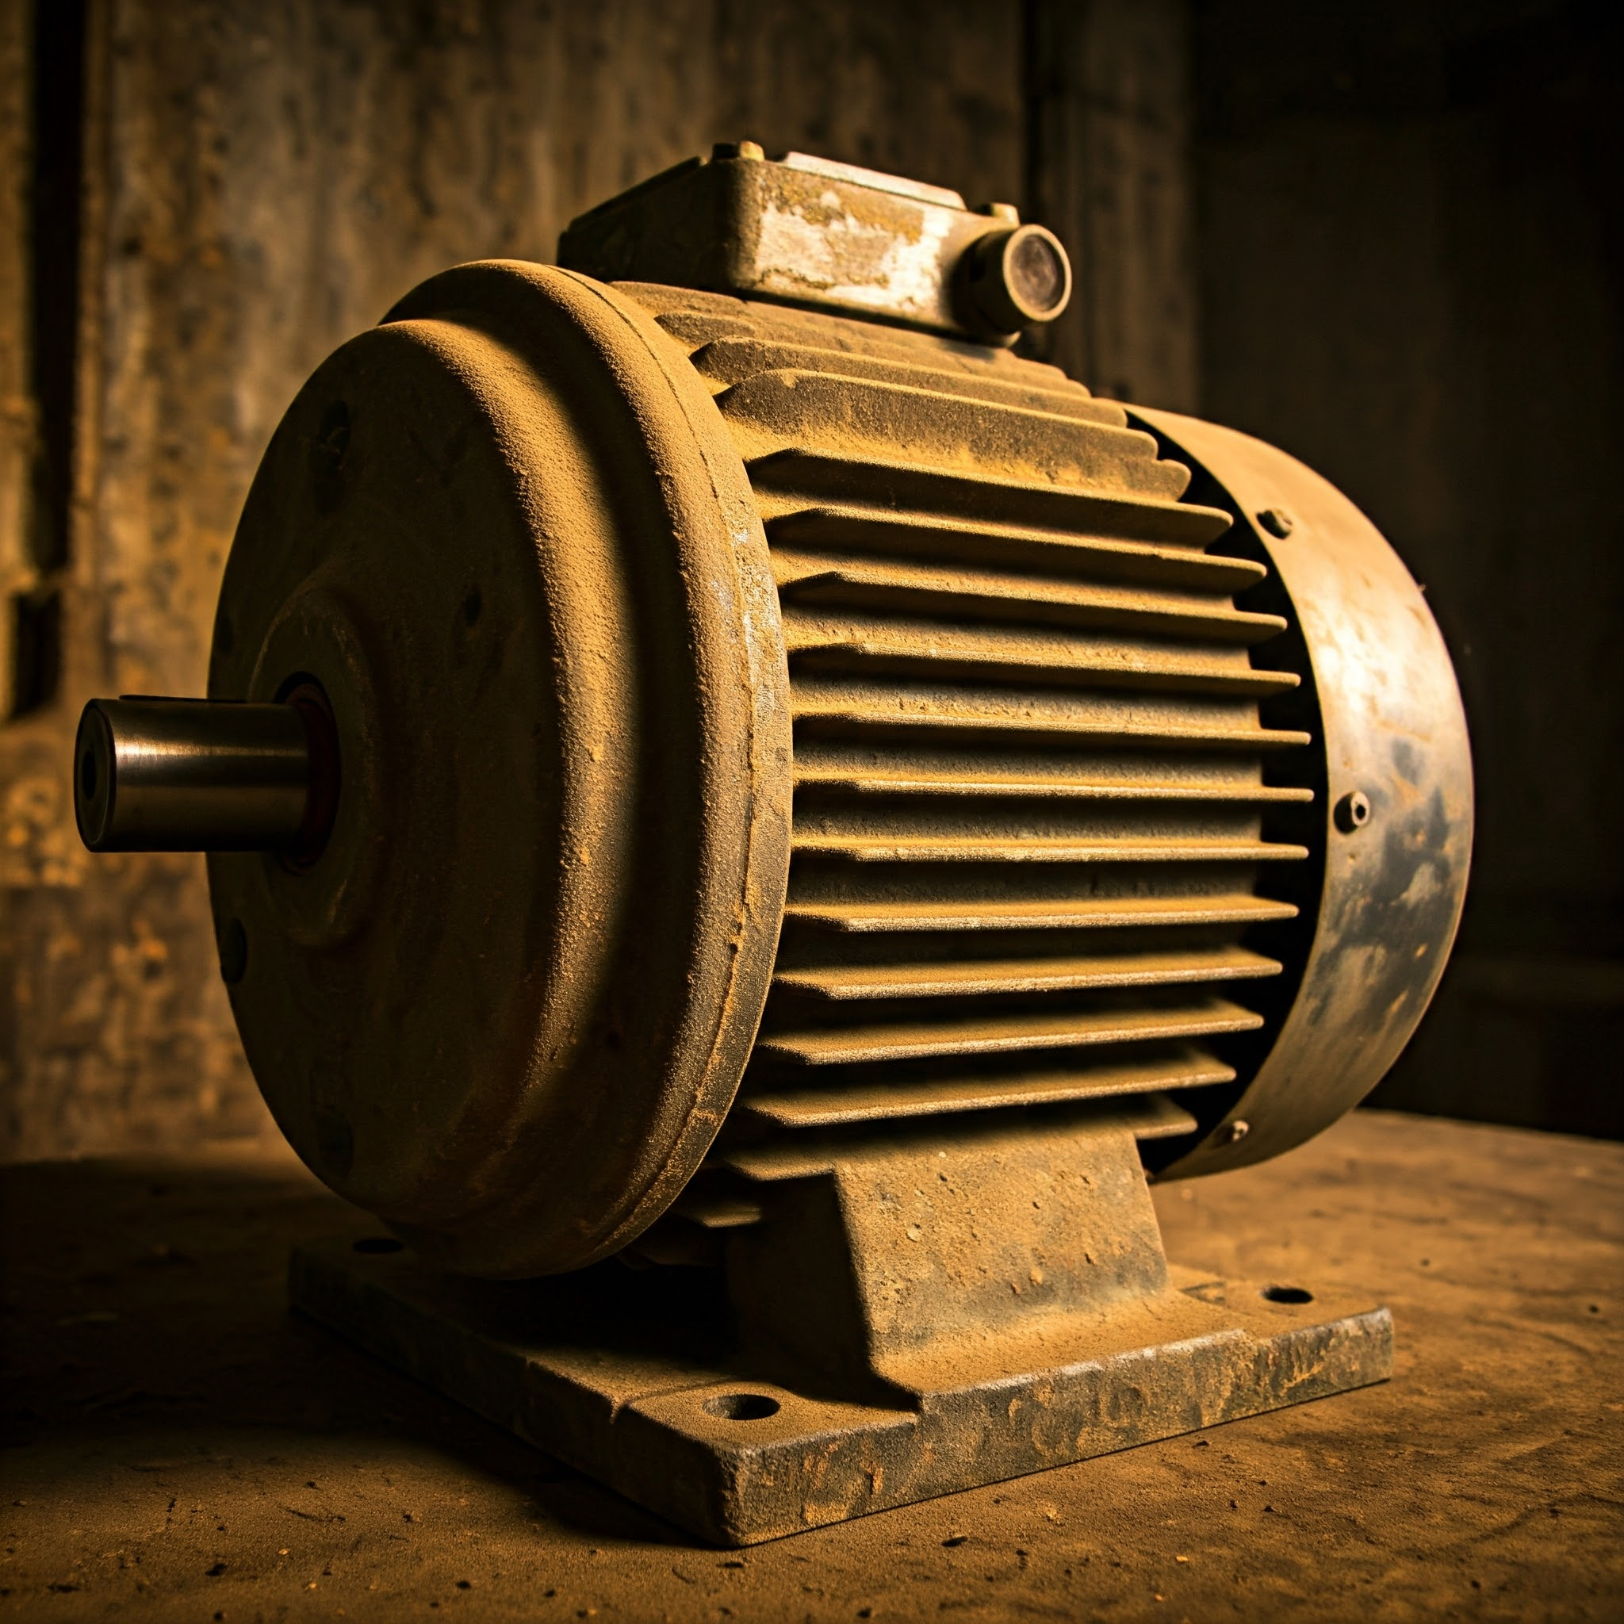
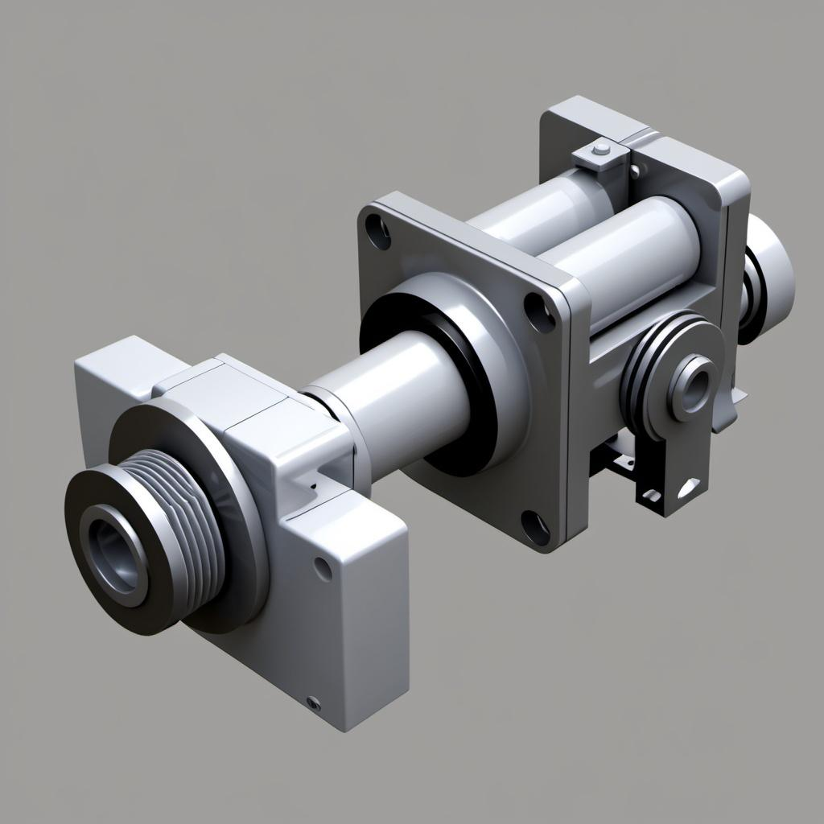
Actuator Mechanisms
Linear Motion Mechanisms: Actuators that create straight-line motion (e.g., linear actuators using screws or pistons).
Rotary Motion Mechanisms: Actuators that provide rotational movement, often using gears and motors to facilitate tasks such as rotating a camera or adjusting the angle of solar panels.

Slide 10
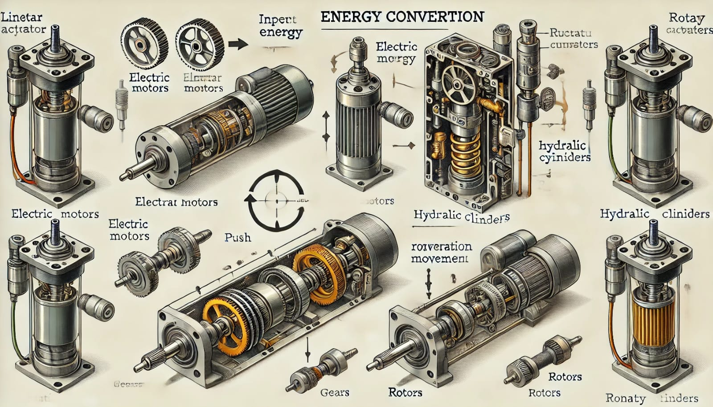

Slide 11
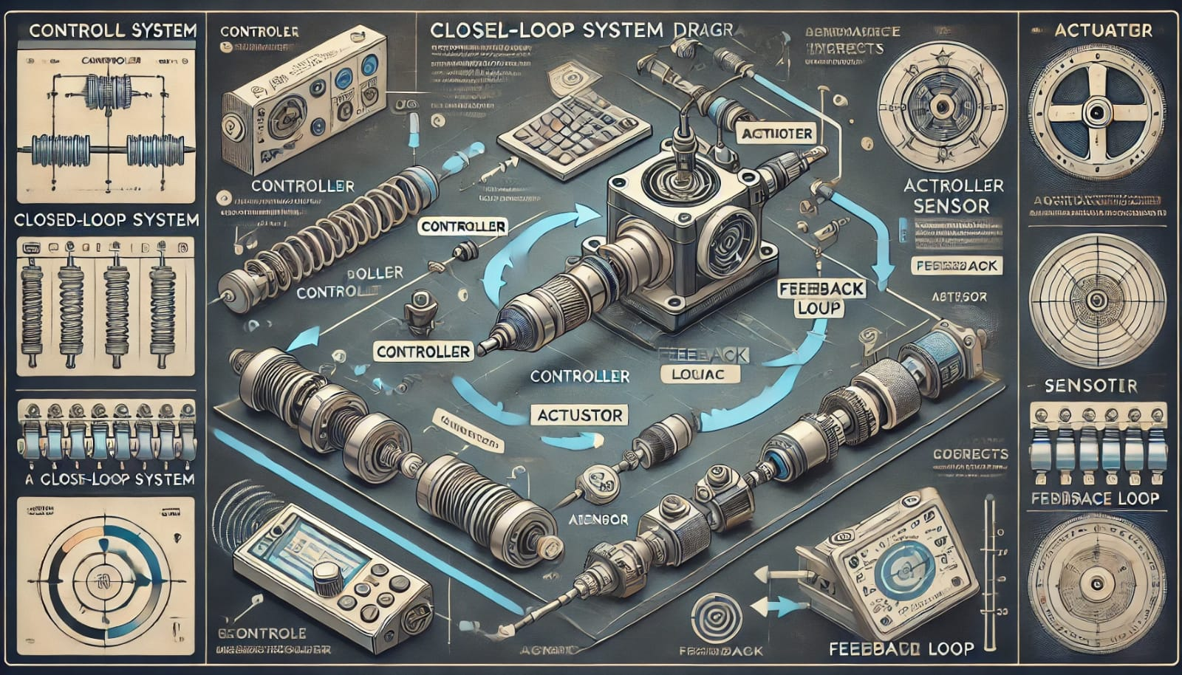
Control Systems for Actuators

Slide 12
Innovative Applications
Smart Homes
Explanation Text:
Smart homes incorporate various sensors and actuators to enhance convenience and energy efficiency. Examples include:
Smart Thermostats: Learn user preferences and adjust heating/cooling accordingly.
Smart Lighting Systems: Automatically adjust brightness based on ambient light levels.
Security Systems: Utilize motion detectors and cameras for monitoring.

Slide 13
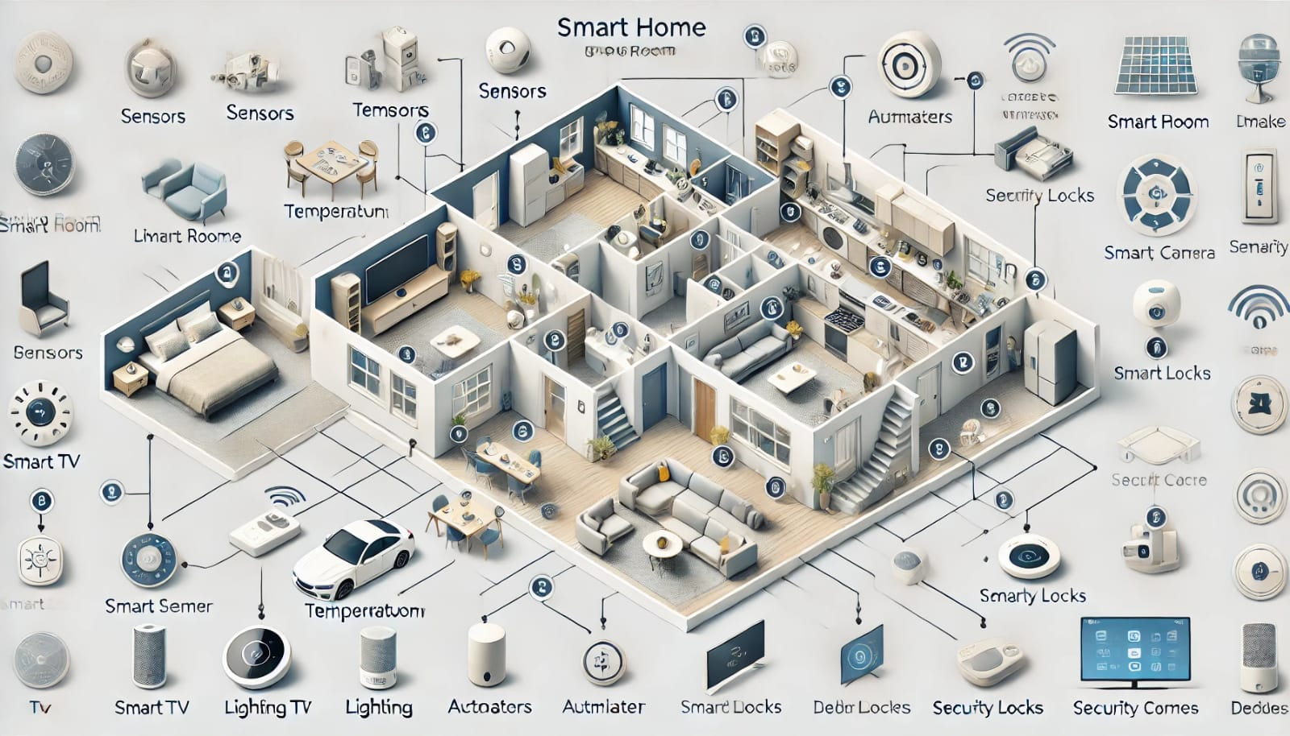

Slide 14
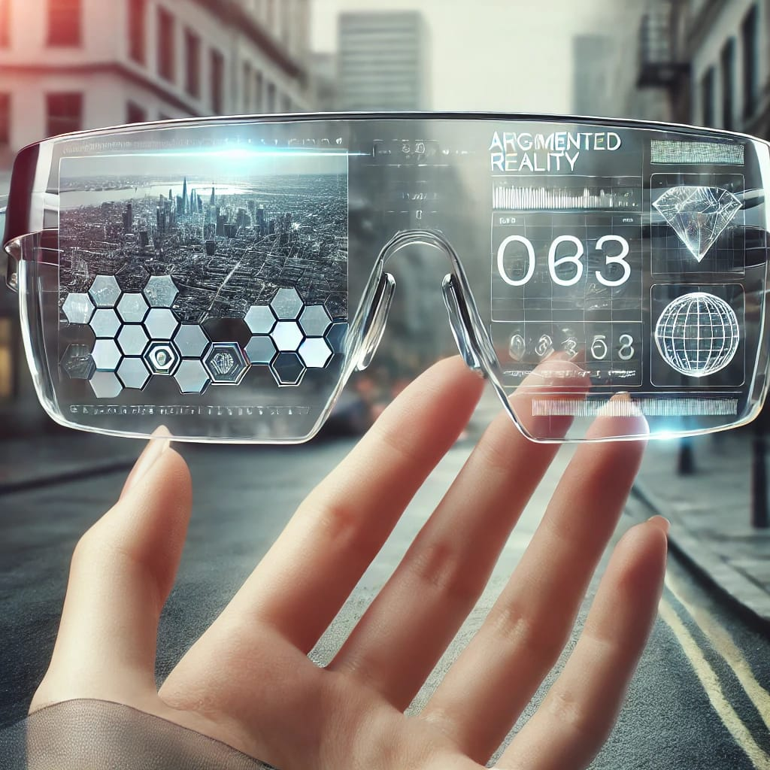
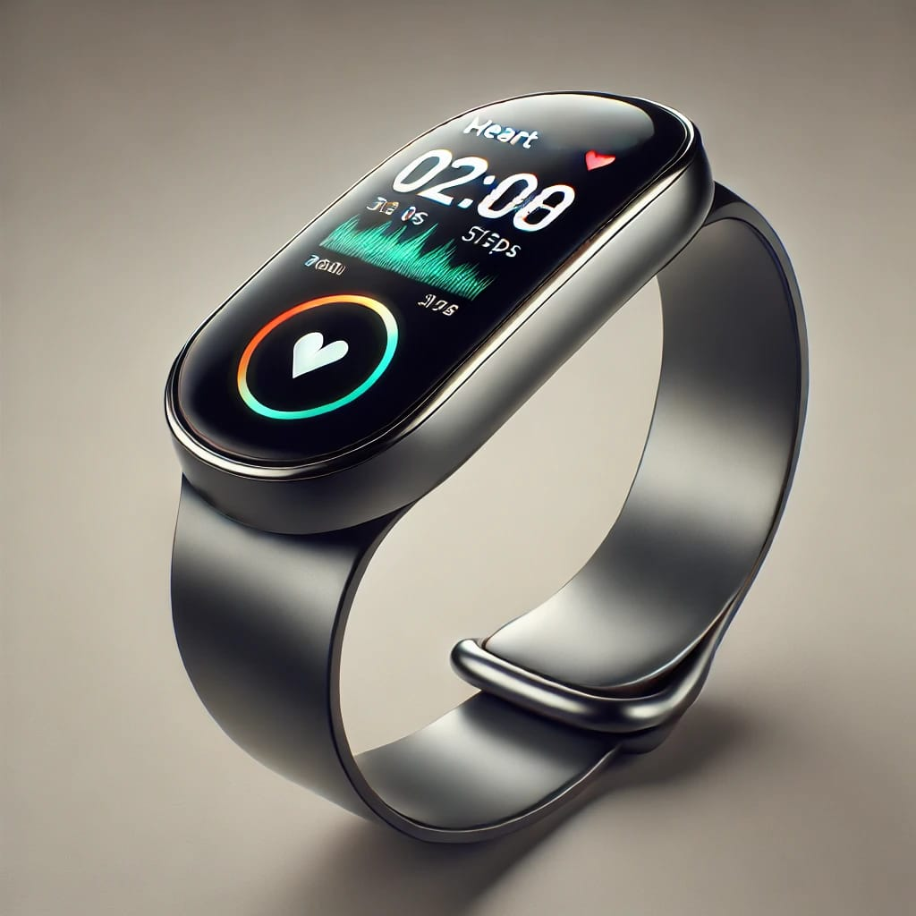
Wearable Technology
Wearable devices, such as fitness trackers and smartwatches, leverage sensors to monitor various health metrics (heart rate, steps taken) and actuators for feedback (vibrations, alerts). They provide users with real-time data to support health and fitness goals.

Slide 15
Industrial Automation
In industrial settings, sensors and actuators work in tandem to automate processes, improving efficiency, precision, and safety. Here are two key examples:
Robotic Arms:
Sensors for Object Detection: Vision, proximity, and force sensors help detect and measure the size and position of objects.
Actuators for Manipulation: Electric, hydraulic, or pneumatic actuators control the movement, enabling precise tasks like picking, rotating, or assembling components.
Feedback Loop: Sensors provide real-time data to actuators, allowing adjustments for accurate handling and reducing errors.
Conveyor Systems:
Sensors for Product Flow Monitoring: Photoelectric and infrared sensors detect product position and speed on conveyor belts.
Actuators for Control: Motors, driven by actuators, adjust the belt’s speed and direction based on sensor input, ensuring smooth flow and automated sorting.
Safety and Quality Control: Sensors monitor for hazards or defects, triggering actuators to stop or sort products when needed.

Slide 16
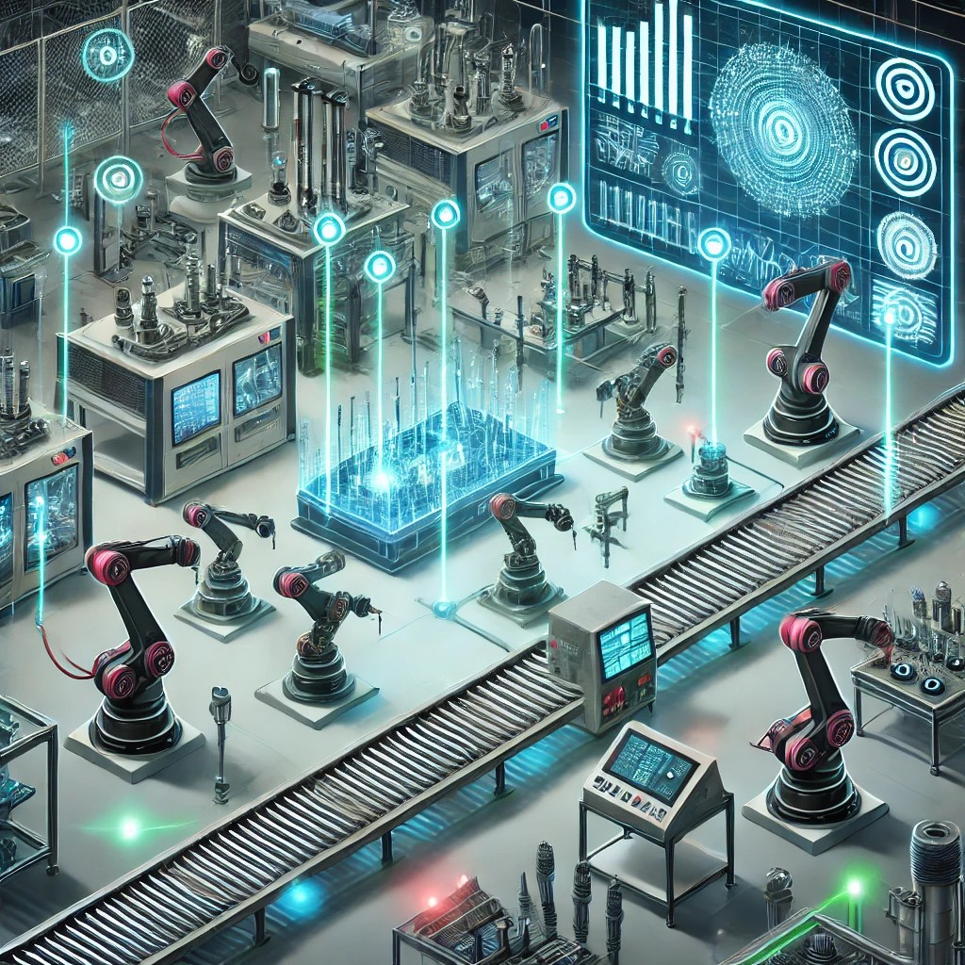

Slide 17
Future Trends and Research Directions
Emerging Sensor Technologies:
The field of sensor technology is rapidly advancing, leading to groundbreaking innovations that promise to revolutionize various industries. Two key emerging trends are:
1. Nano-Sensors:
Ultra-Sensitive Detection: Nano-sensors are incredibly small sensors capable of detecting minuscule changes at the atomic or molecular level. These sensors can measure tiny environmental variations, such as chemical concentrations, pressure, or temperature changes, with extreme precision.
Applications:
Medical Diagnostics: Nano-sensors can detect biomarkers in bodily fluids, enabling early diagnosis of diseases like cancer and diabetes.
Environmental Monitoring: They can be deployed to detect pollutants at very low concentrations, offering new ways to monitor air and water quality, providing early warning for pollution or hazardous conditions.
2. Smart Sensors:
Integrated Processing Capabilities: Smart sensors combine sensing, processing, and communication into a single unit. These sensors can analyze data in real time and make decisions without relying on external computing resources.
Applications:
Autonomous Vehicles: Smart sensors help process road conditions, obstacles, and traffic patterns in real time to enhance safety and navigation.
Industrial Automation: In smart factories, sensors can monitor equipment performance and make adjustments autonomously to prevent breakdowns or improve efficiency, contributing to the rise of Industry 4.0.

Slide 18
Advances in Actuator Design
Recent advances in actuator design have led to more efficient, precise, and adaptable systems, transforming industries like robotics, healthcare, and aerospace. Key advancements include:
1. Soft Actuators:
Flexible and Adaptable: Soft actuators are made from materials like silicone and rubber, allowing them to bend, twist, or stretch. This flexibility makes them ideal for delicate tasks, such as handling fragile objects or interacting with humans in medical applications.
Applications:
Robotic Surgery: Soft actuators enable robotic systems to perform minimally invasive surgeries with greater precision and flexibility, reducing trauma to surrounding tissues.
Wearable Devices: Used in exoskeletons and assistive technologies to provide more natural movement and enhanced user comfort.
2. Piezoelectric Actuators:
High Precision Movement: Piezoelectric actuators generate movement when an electrical voltage is applied. They are known for their high precision, rapid response time, and ability to operate at micro and nano scales.
Applications:
Micromanipulation: Used in microelectromechanical systems (MEMS) and nanotechnology for tasks requiring extreme precision, such as moving microscopic objects or controlling optical systems.
Vibration Control: Piezoelectric actuators are employed in active vibration control systems, improving the stability and performance of structures like aircraft and bridges.
3. Magnetic Shape Memory Actuators:
Rapid Response and Force Generation: These actuators change shape in response to a magnetic field, offering high-speed actuation and significant force output, which is especially useful in dynamic environments.
Applications:
Aerospace Systems: Used in aircraft control surfaces and space exploration equipment due to their quick response and ability to handle extreme conditions.

Slide 19
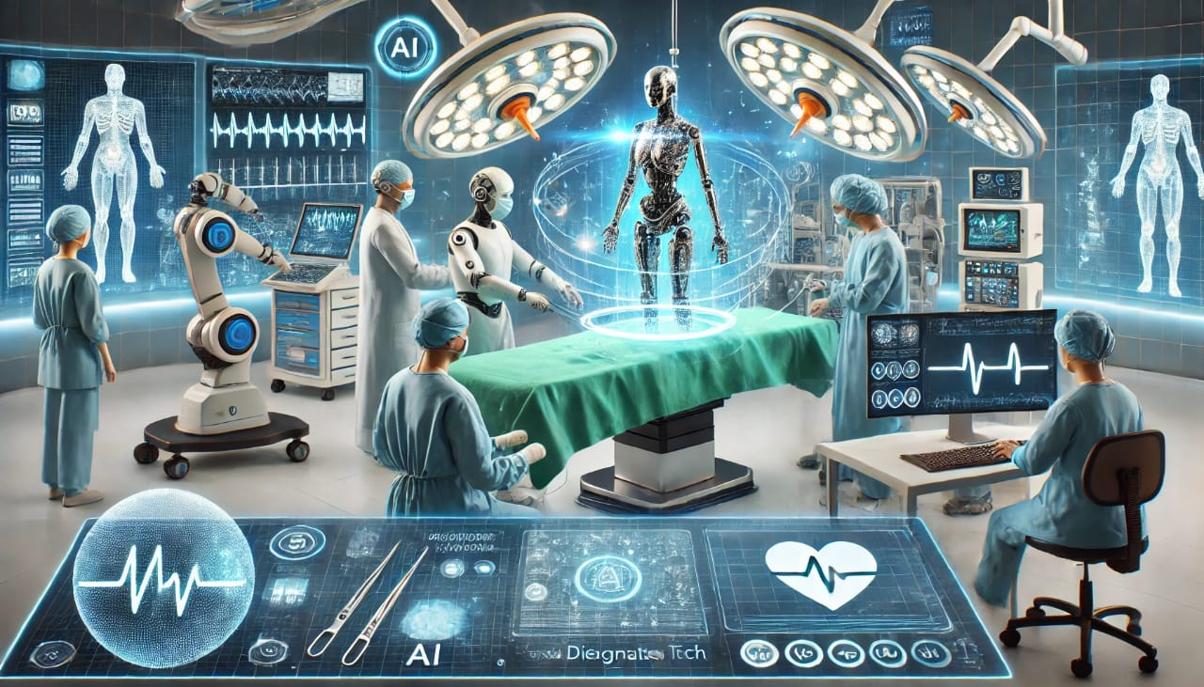
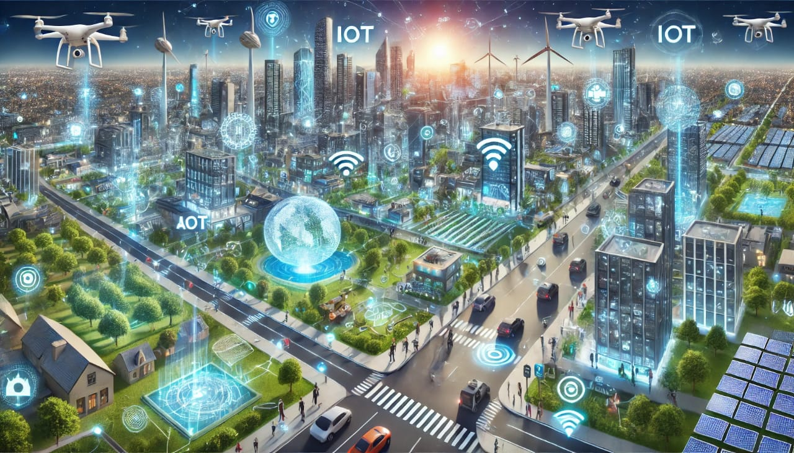

Slide 20
Potential Future Applications
The integration of advanced sensors and actuators is driving innovation across multiple fields, setting the stage for exciting future applications. Some of the most promising areas include:
1. Healthcare and Bio-Medical Devices:
Smart Prosthetics: Combining sensors and actuators, future prosthetics will mimic natural movement with unprecedented precision. Sensors can detect muscle impulses, while actuators enable lifelike movements in prosthetic limbs, improving the quality of life for amputees.
Remote Surgery: Robotic systems with highly sensitive sensors and precise actuators could enable remote surgeries, where a surgeon operates on a patient in another location using teleoperation, enhancing access to specialized care globally.
2. Autonomous Transportation:
Self-Driving Cars: Advanced sensors (e.g., LIDAR, cameras, radar) will allow autonomous vehicles to navigate complex environments, while actuators control the vehicle’s steering, acceleration, and braking. Future advancements will enhance safety and efficiency, making driverless transportation mainstream.
Drones and Delivery Robots: Sensors guide drones in real-time obstacle avoidance, while actuators control flight dynamics. Future applications could include widespread drone-based package delivery or emergency response.
3. Smart Cities:
Intelligent Infrastructure: Future smart cities will use sensors embedded in roads, bridges, and buildings to monitor structural health, traffic flow, and environmental conditions. Actuators will adjust lighting, traffic signals, and public transportation systems dynamically, improving energy efficiency and reducing congestion.
Waste Management: Sensors in trash bins can detect fill levels and actuators in autonomous waste collection vehicles will optimize collection routes, making waste disposal more efficient.
4. Environmental Monitoring and Agriculture:
Precision Agriculture: Sensors can monitor soil moisture, nutrient levels, and weather conditions, while actuators control irrigation systems, pesticide.

Slide 21
Ongoing Research and Future Trends
The fields of sensors and actuators are continuously evolving, driven by cutting-edge research and new technological advancements. Some of the most prominent ongoing research areas and future trends include:
1. Self-Powered Sensors:
Energy Harvesting: Researchers are developing sensors that can generate their own power by harvesting energy from their environment, such as through vibrations, light, or heat. These sensors are crucial for applications where replacing batteries is challenging, such as remote monitoring systems or wearables.
Potential Applications: Self-powered sensors could be used in wearable health monitors, long-term environmental sensors, and industrial machinery to continuously gather data without needing external power sources.
2. Artificial Intelligence (AI) Integration:
AI-Driven Smart Sensors: The integration of artificial intelligence with sensor technology allows for smarter, more autonomous decision-making. AI-powered sensors can process data in real-time, learning from patterns and predicting outcomes, enhancing applications like autonomous vehicles, predictive maintenance, and robotics.
Future Applications: AI-enhanced sensors will lead to improvements in healthcare diagnostics, more efficient energy management in smart grids, and more advanced autonomous systems.
3. Bio-Inspired Actuators:
Nature-Inspired Mechanisms: Ongoing research in actuators focuses on replicating natural movement and adaptability, inspired by animals and plants. These bio-inspired actuators aim to create machines and robots that can move and adapt to their surroundings with greater fluidity and flexibility.
Potential Applications: Soft robotics, prosthetics, and advanced wearable technologies could benefit from bio-inspired actuators, offering more natural and efficient movements in real-world environments.
4. Miniaturization and Nano-Actuators:
Smaller, Faster, Stronger: Researchers are pushing the boundaries of miniaturization, creating nano-actuators that are incredibly small but capable of delivering precise movements at microscopic scales. These actuators are crucial for advancements in nanotechnology and medical devices.
Future Applications: Nano-actuators will play a key role in drug delivery systems, lab-on-a-chip devices, and even in the development of molecular machines capable of performing tasks at the cellular level.

Slide 22
THANK YOU!!!

